Slide 1
Python Project Deployment METHODS
-- G.Vinay

Slide 2
Introduction
This presentation covers various methods for deploying Python applications on AWS EC2 instances.
We'll explore approaches such as manual deployment, Docker, Kubernetes, Jenkins, Terraform, and more.

Slide 3
Method 1: Manual Deployment
Deploy Python applications manually by launching EC2 instances and configuring environment.
Example applications: Flask, Car Prediction, Fish Prediction.
Steps:
1. Launch EC2 instance with necessary ports.
2. Install Python, Git, and application dependencies.
3. Run the application and access via public IP and port.

Slide 4


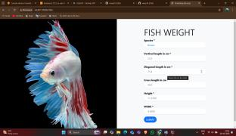
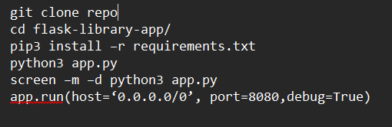
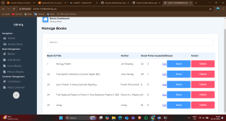
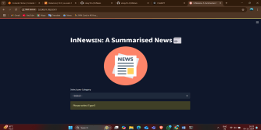
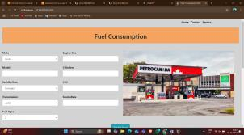

Slide 5
Method 2: User Data Script Deployment
Use EC2 User Data script to automate deployment at instance launch.
Steps:
1. Launch EC2 instance with a User Data script.
2. Script includes installing Git, Python, and cloning application.
3. Run application on startup and access via public IP.

Slide 6
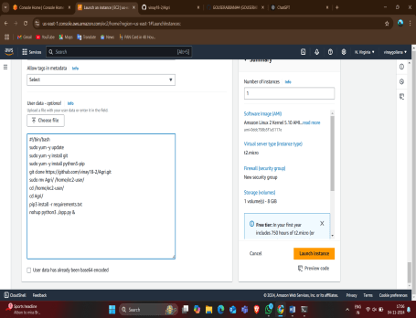
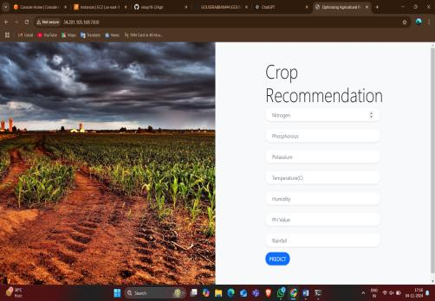

Slide 7
Method 3: Bash Script Deployment
Automate deployment using custom bash scripts.
Steps:
1. Launch EC2 instance.
2. Write bash script for deployment tasks.
3. Execute bash script to complete setup.
4. Access application using EC2 public IP and port.

Slide 8
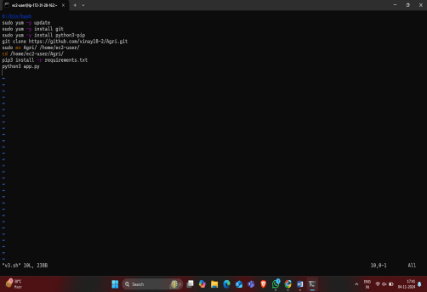


Slide 9
Method 4: Git, GitHub, and Jenkins
Automate deployment with Jenkins jobs.
Steps:
1. Launch EC2 instance and install Jenkins.
2. Create Jenkins job to clone GitHub repo and execute deployment script.
3. Access application through public IP.

Slide 10
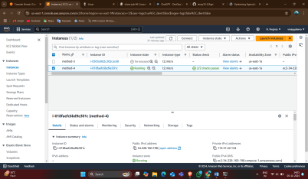
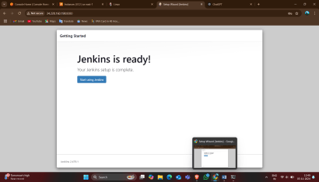
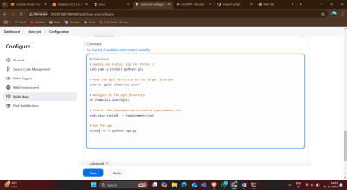
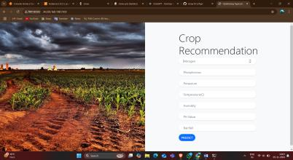

Slide 11
Method 5: Terraform Deployment
Use Terraform to automate AWS resource creation and application deployment.
Steps:
1. Write Terraform scripts for EC2, VPC, Security Groups, etc.
2. Run 'terraform apply' to launch resources.
3. Access application using EC2 public IP and configured ports.

Slide 12
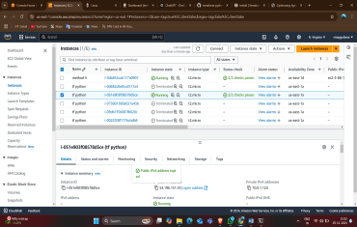
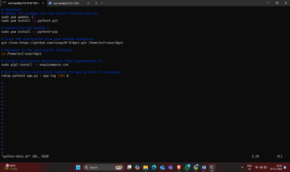
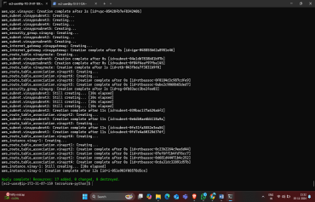


Slide 13
Method 6: Jenkins and Terraform
Integrate Jenkins with Terraform for automated deployments.
Steps:
1. Set up Jenkins with AWS credentials.
2. Configure job to execute Terraform scripts.
3. Resources are created and application deployed on AWS.

Slide 14
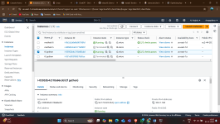
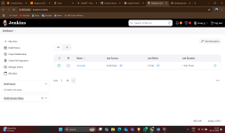
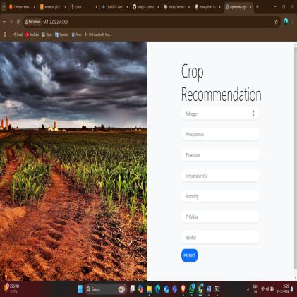
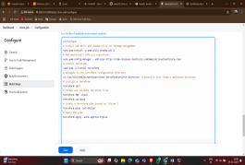
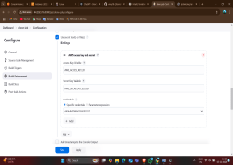

Slide 15
Method 7: Docker Deployment
Use Docker to containerize applications for consistent deployment.
Steps:
1. Create Dockerfile and build Docker image.
2. Run Docker container on EC2.
3. Access application using public IP and container port.

Slide 16
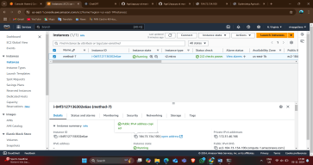
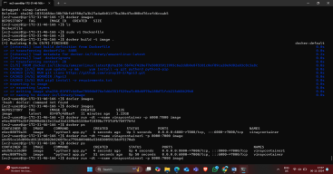
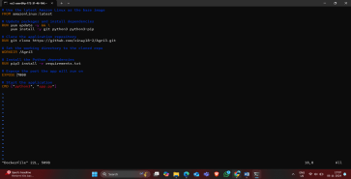


Slide 17
Method 8: Kubernetes with EKS and KOPS
Deploy applications on Kubernetes cluster using Docker images.
Steps:
1. Configure and launch Kubernetes cluster using KOPS or EKS.
2. Use deployment and service YAML files to deploy Docker image.
3. Access application through Load Balancer DNS.

Slide 18
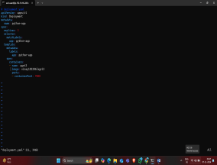
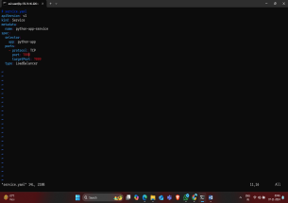
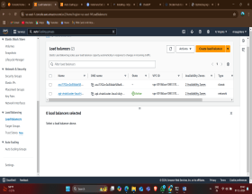
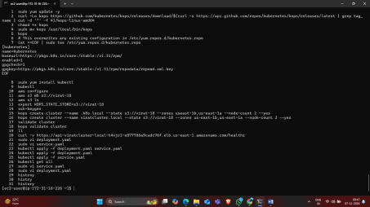
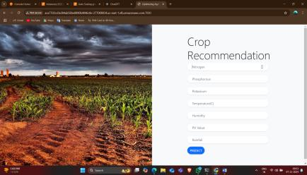

Slide 19
Method 9: Jenkins with Webhooks,Buil periodic,Poll scm
Automate deploy python application with Jenkins webhooks and periodic builds.
Steps:
1. Set up GitHub webhook and configure Jenkins job.
2. Run Terraform scripts for deployment.
3. Periodic checks and builds ensure continuous deployment.

Slide 20
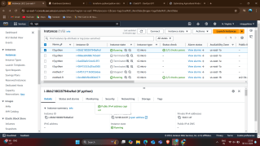
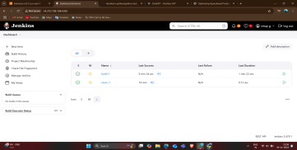
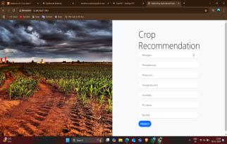

Slide 21
Method 10: Jenkins Pipeline
Build a Jenkins pipeline with multiple stages for deployment.
Steps:
1. Create clone and build jobs in Jenkins.
2. Configure webhooks and periodic polling.
3. Use pipeline plugin to manage deployment stages.

Slide 22
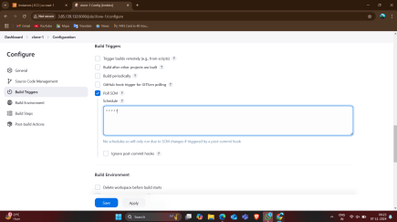
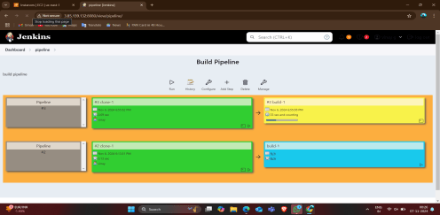
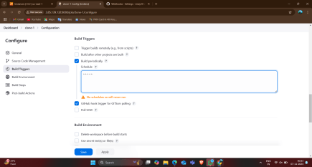
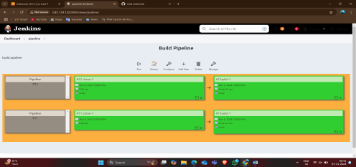

Slide 23


